Slide 1
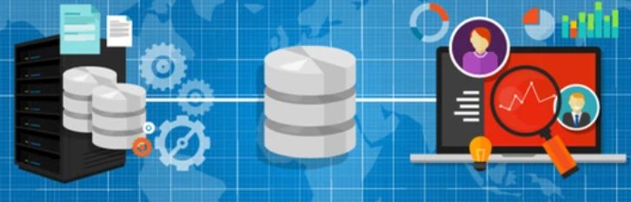
Data and Analytics
From Business Process to Business Insights

Slide 2
Business Intelligence and Data Analytics
Bi is the practice of gathering and storing the firm’s data assets along with business knowledge and reporting the results.
Data analytics expands on that intelligent data with predictive and prescriptive data science using statistics and machine learning.
Let’s see how this can add value to the the firm.
Notes:
BI is where we gather, store and report on the business using data.
With analytics we use Data Science to dig deeper into the data .
All done with the goal of adding value to the business.

Slide 3
Value of a Firm
The value of a Firm is shaped by two concepts: It’s business model and its operating model.
The business model is the promise to create value for its customers and encompasses the business strategy
The operating model defines how the business delivers that value.
Notes:
We can think of a firm as comprised of a business model or “Value Proposition” and an operating model. or “Delivery System”

Slide 4
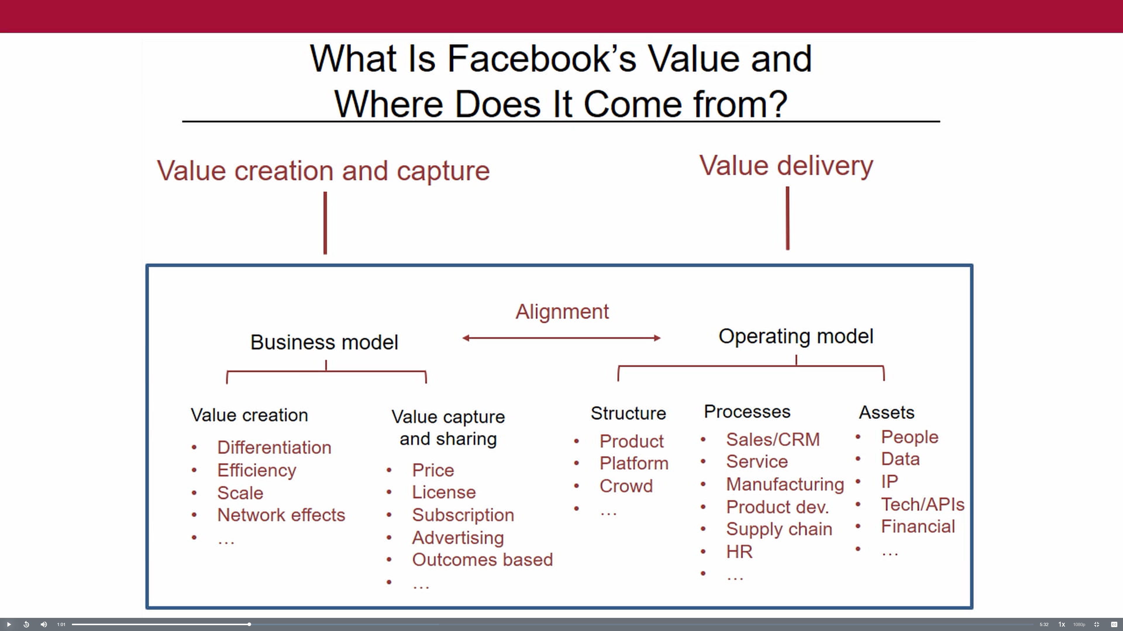
Create Value
First, a business creates value through a customer promise or value proposition such as Helping to achieve the customers’ retirement goals.
Capture Value
Second, a business captures value with a cost-effective product or service delivered through an operating model carefully aligned with the business model
Notes:
Value comes from the Business Processes that Deliver the customer promise or Value Proposition.

Slide 5
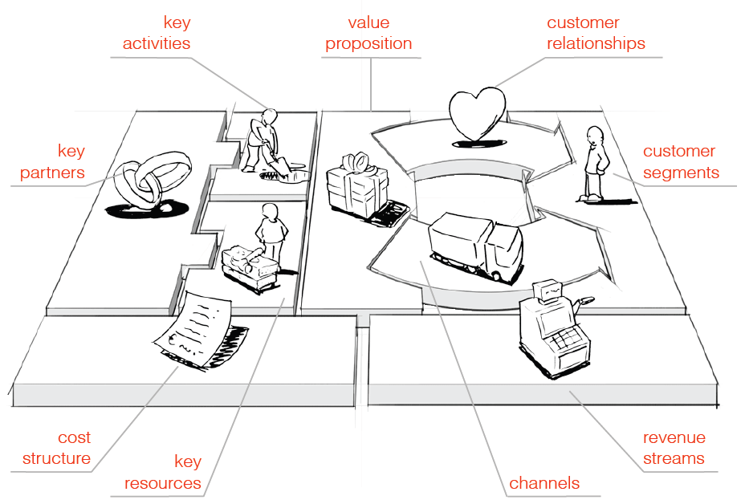
Business-Operating Model
The business operating model defines how a firm creates and captures value through its business processes.
In today’s economy we must measure all the building blocks that define the model
The key to measuring your business model is DATA
Notes:
Recall the Question: ¿How does Business Intelligence add value to the firm? The KEY is analyzing that DATA generated by your BUSINESS PROCESS. A good starting point is with a Data Warehouse.

Slide 6
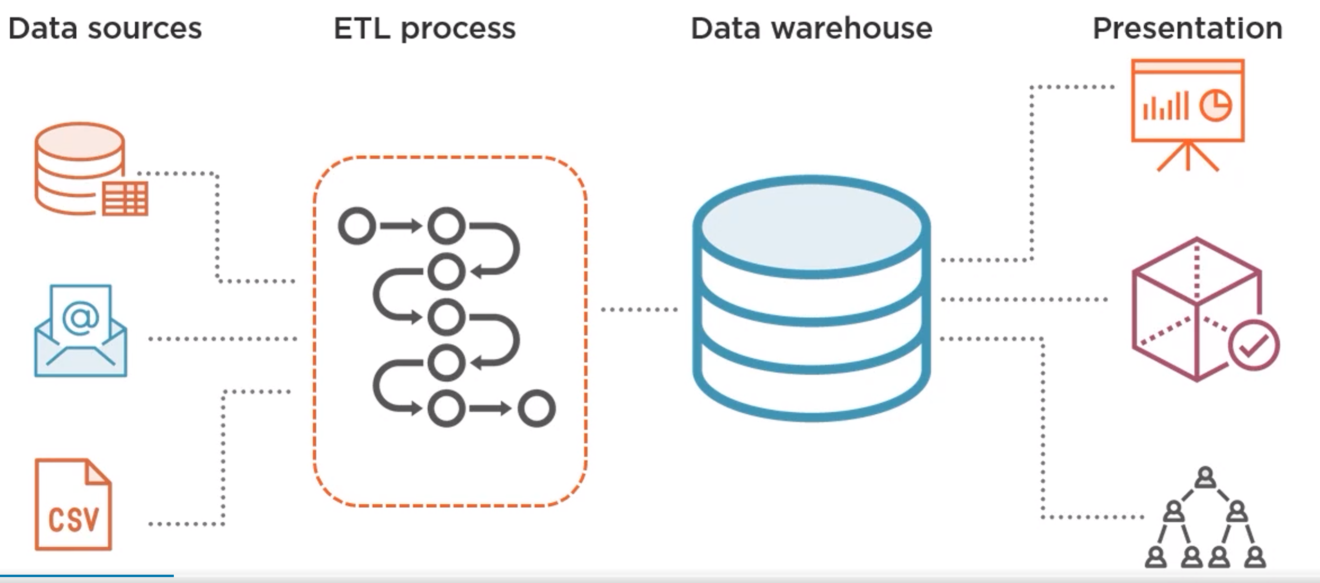
Delivering Business Intelligence
Notes:
Business Intelligence takes data from multiple sources and systems. Then through a process called ETL– Extracts source data E; Transforms or (cleans, validates and standardizes the data elements) T; and Loads it into a new database L. So, the Data Warehouse contains what you might think of as smart/intelligent data, that has been organized and aggregated for analysis. This new database (or Data Warehouse) stores data organized as Facts and Dimensions which is optimized for Analytics. The Data Warehouse then becomes the source for Presentation with tools like Power BI and Tableau, further aggregation into data structures called Cubes that contain pre-computed “hierarchies” and KPIs, and the Data Warehouse easily services a multitude of users without placing additional strain on the original Data Source systems. Analytics queries often require access to complex datasets across Ks or Ms of records that can drain Source System resource capacity. The Data Warehouse isolates that analytics burden. There are still “Problems” or “Challenges” that must be addressed. First is the quantity of Data. The Data Warehouse must be “Designed and Maintained” such that it hosts Important and Relevant data. The Data Warehouse must join data from disparate Source systems across the organization. Finally, the Data Warehouse must be validated so that it can be recognized as the “One Source of Truth” for the Organization.

Slide 7
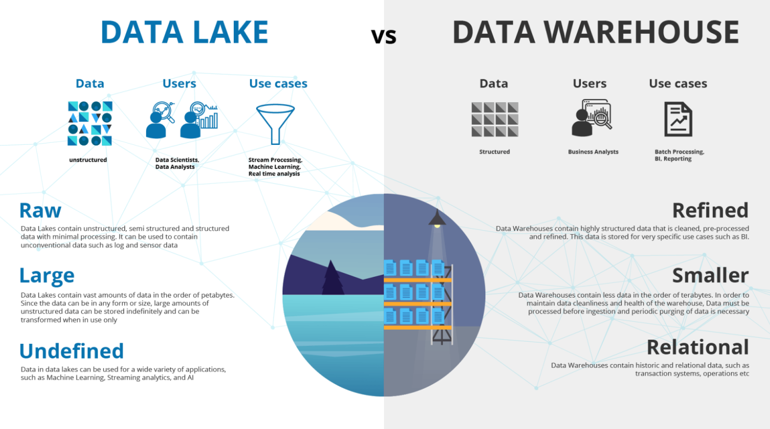
Data Lake vs Data Warehouse Comparison
Notes:
A Data Lake can be deceptive, however. It doesn’t magically give you access to historical trends or insights by virtue of storing data. Just like that picture of you partying in 1999! A Data Lake is often the precursor or “Staging Area” for a Data Warehouse.

Slide 8
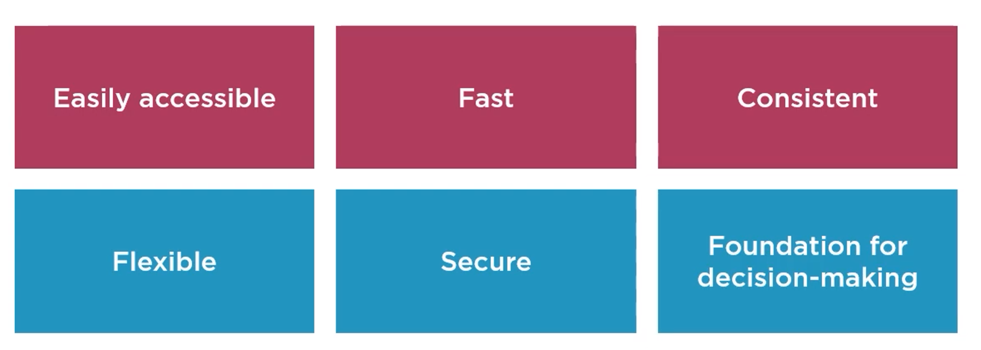
Requirements of a Data Warehouse Solution
Notes:
Easy access includes using Business Vocabulary vs. Tech Lingo. Fast so as to minimize the response time. Consistent or “One Source of Truth”.
Flexible to grow/adapt to business changes. Secure so the right people have access to the right information. Reliable 4 Decisions ↑

Slide 9
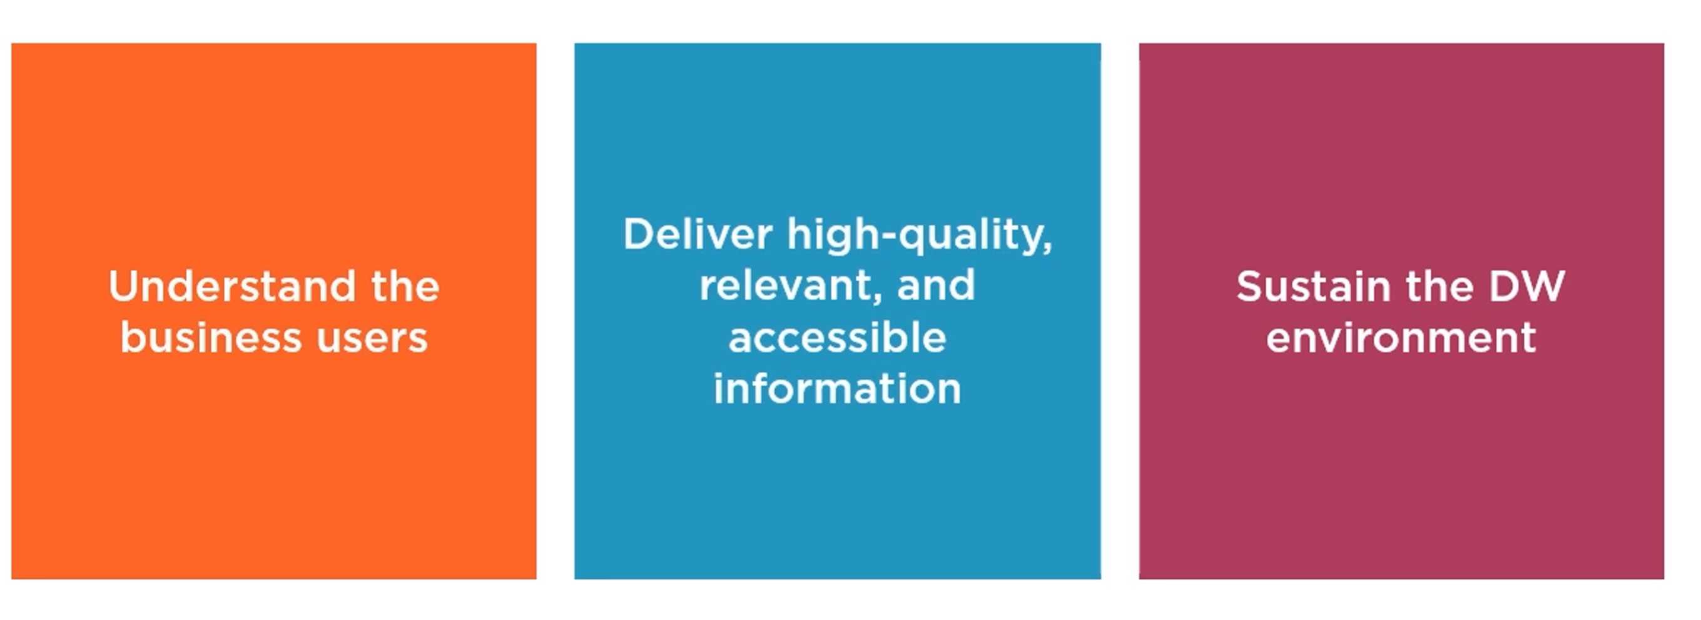
Responsibilities of a Data Warehouse Designer

Slide 10
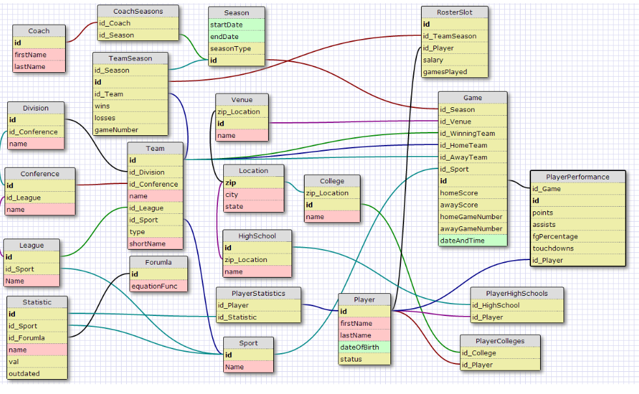
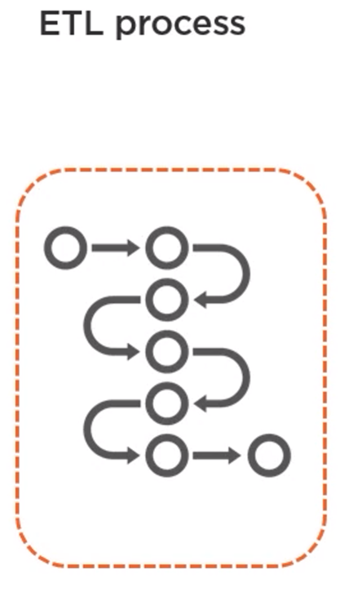
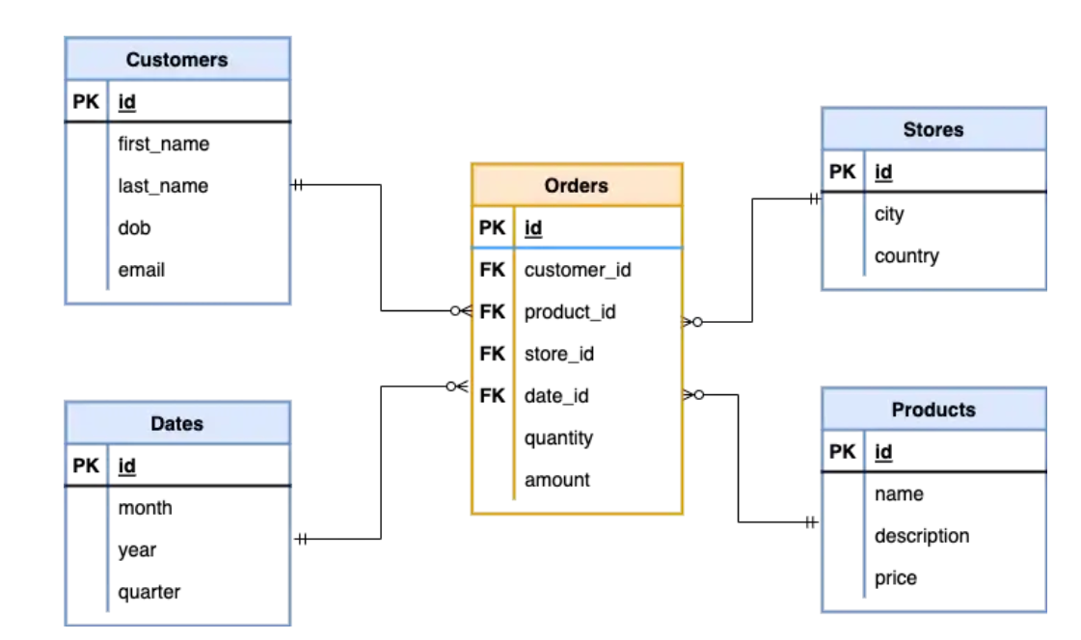
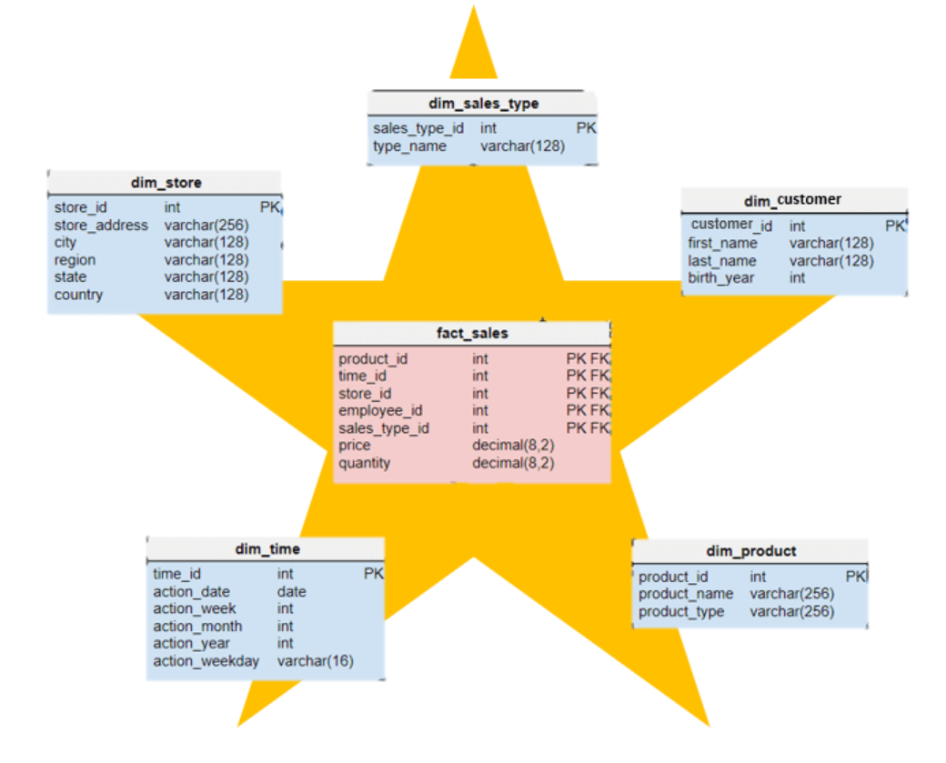
Designing a Dimensional Data Warehouse
Normalized
"The key, the whole key, and nothing but the key, so help me Codd." For Edgar F. Codd
Star Schema
Notes:
Source systems and databases are designed to efficiently capture data from the Business Processes. We call that “Normalization” where each element of data is written only once and stored in a table of similar data elements e.g. Order Processing System.
Data Warehouses are designed for efficiently using data for Business Analytics. We call that “Denormalization” or “Star Schema” where data has been organized into Facts with measures that represent Business Events and Dimensions with attributes that describe the event:
So Orders become the Sales Facts and Customers, Stores, Products and Dates Become the Dimensions. The “Star Schema is our Fact Table surrounded by it’s Dimensions.

Slide 11
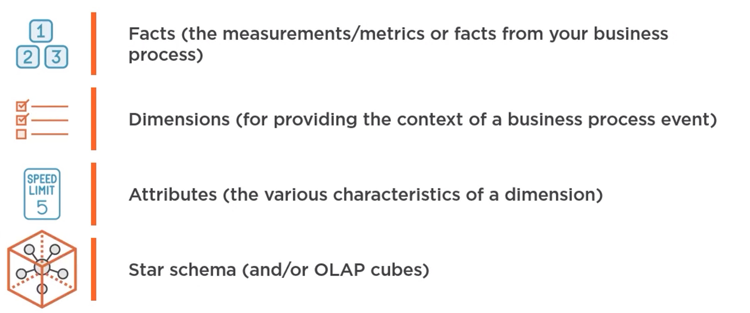
Elements of a Dimensional Model
Notes:
I want to talk a little more about the Star Schema and Cubes

Slide 12
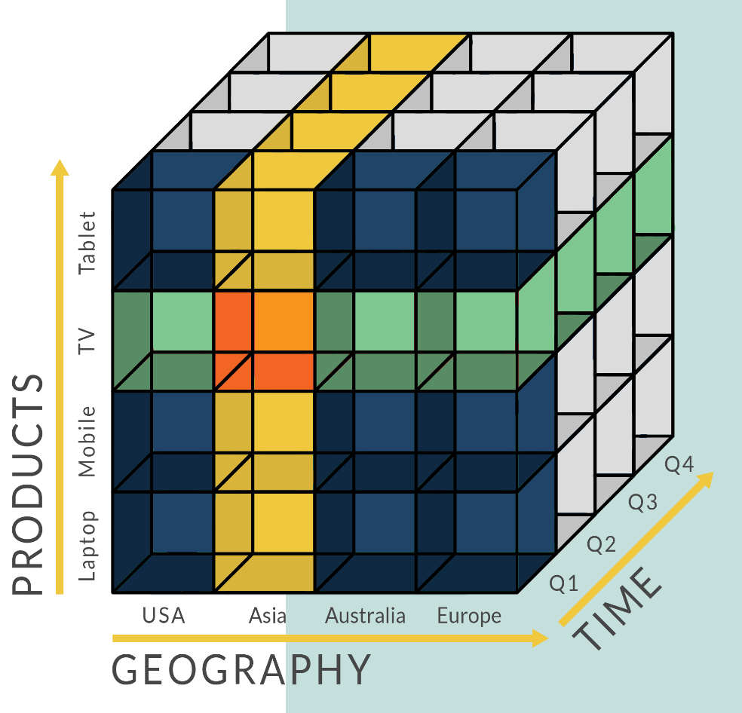
From Star Schema to Cube
Notes:
A Star Schema provides the foundation for the data structure commonly referred to as a “Cube” because it is easy to recognize in 3-Dimensions. Actual “Cubes” usually contain many more dimensions.
The “Cube” pre-processes data for quick analysis. The Orange block represent Sales of TVs from Asia in Q1. A value that is instantly available because it has been pre-calculated.

Slide 13

Know your Business
Notes:
Back to our original question: ¿How does Business Intelligence add Value? We get there by understanding our Business and Business Processes.

Slide 14
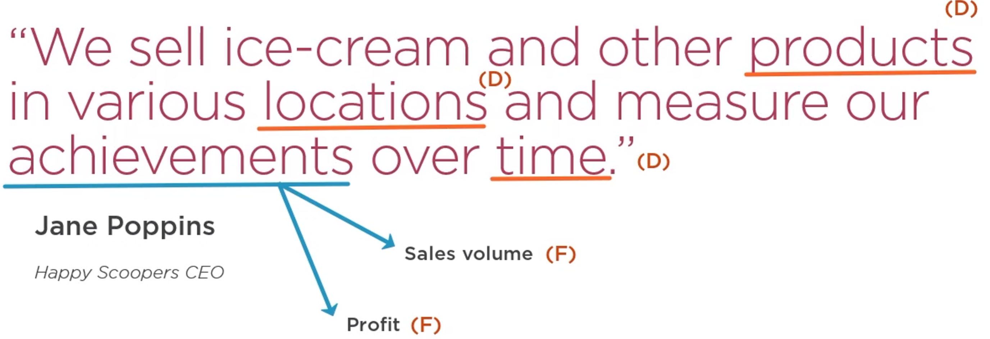
Business Process to Data Warehouse
Notes:
From this simple statement I can start to build a Data Warehouse which is the foundation for Data Analytics. Jump to Data Warehouse Slide.

Slide 15
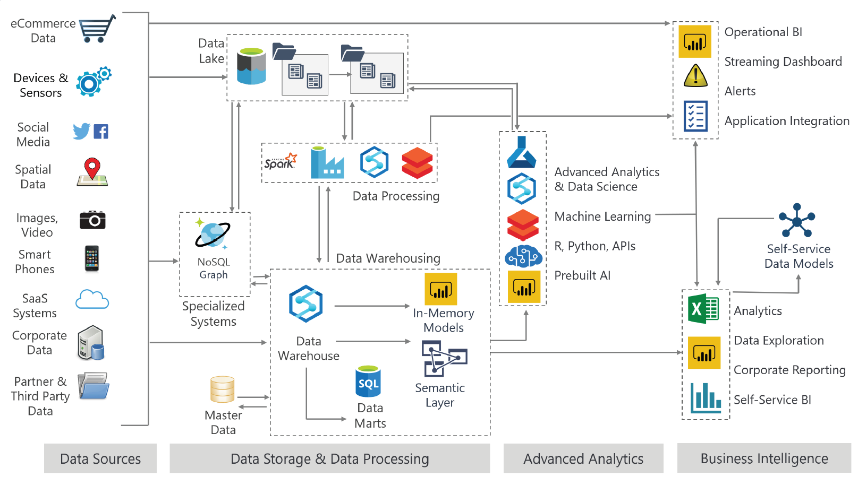
Modern Data Architecture
Notes:
A modern data architecture can be a bit more complex depending on your data source, storage, processing and analytics needs. Our initial data warehouse is this interior box.
The right side of this diagram we often refer to as the “Presentation Layer”.

Slide 16
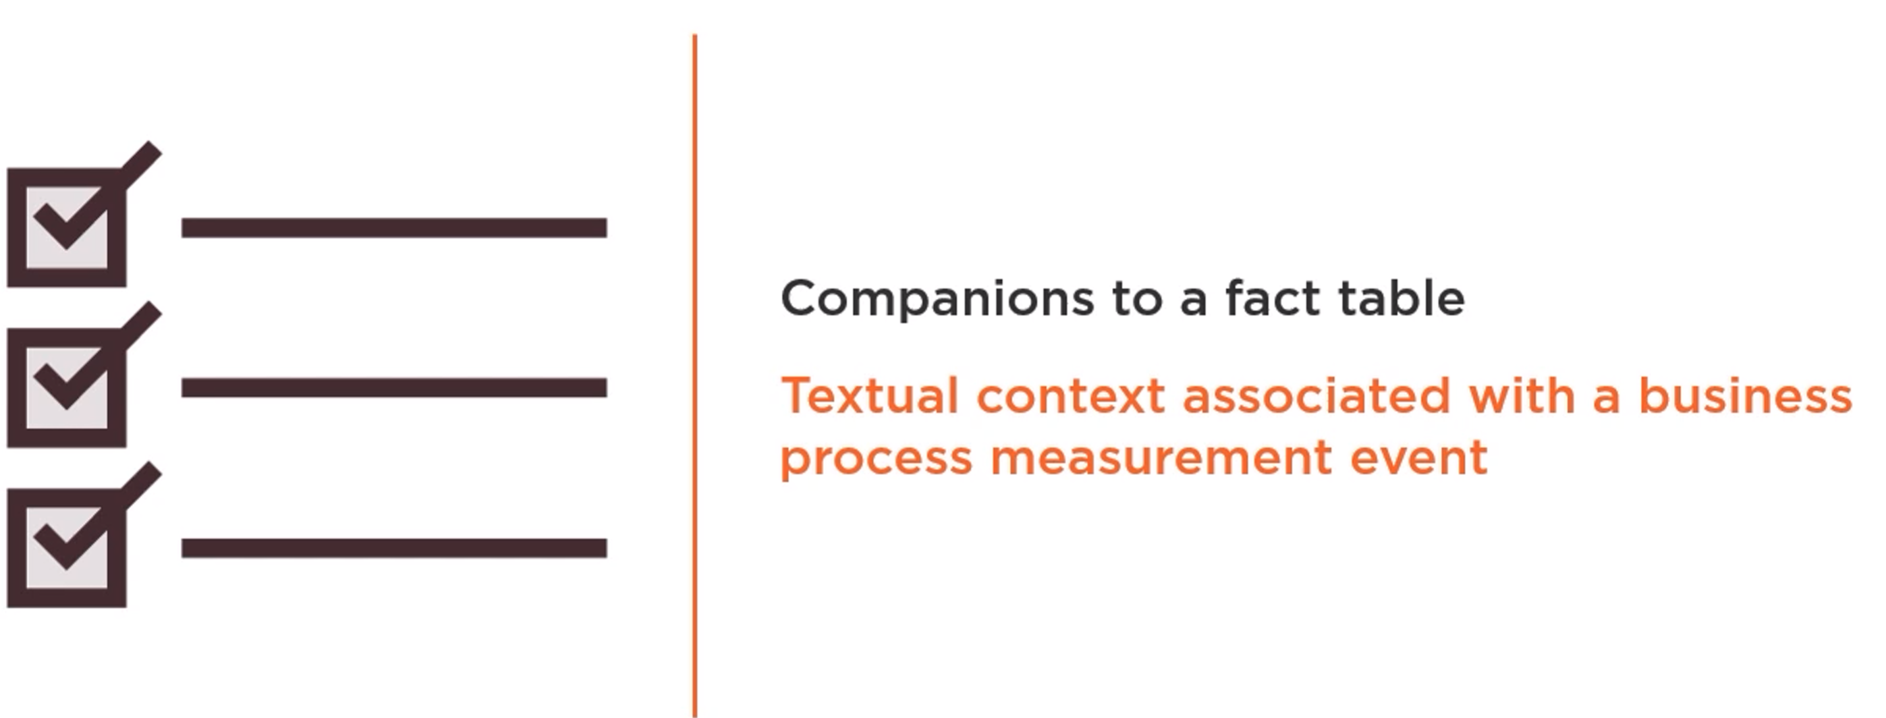
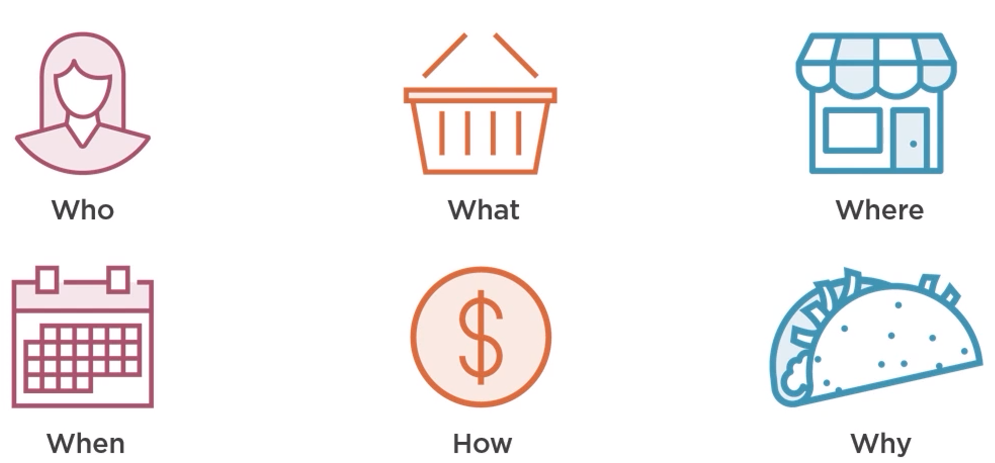
What Are Dimensions?

Slide 17
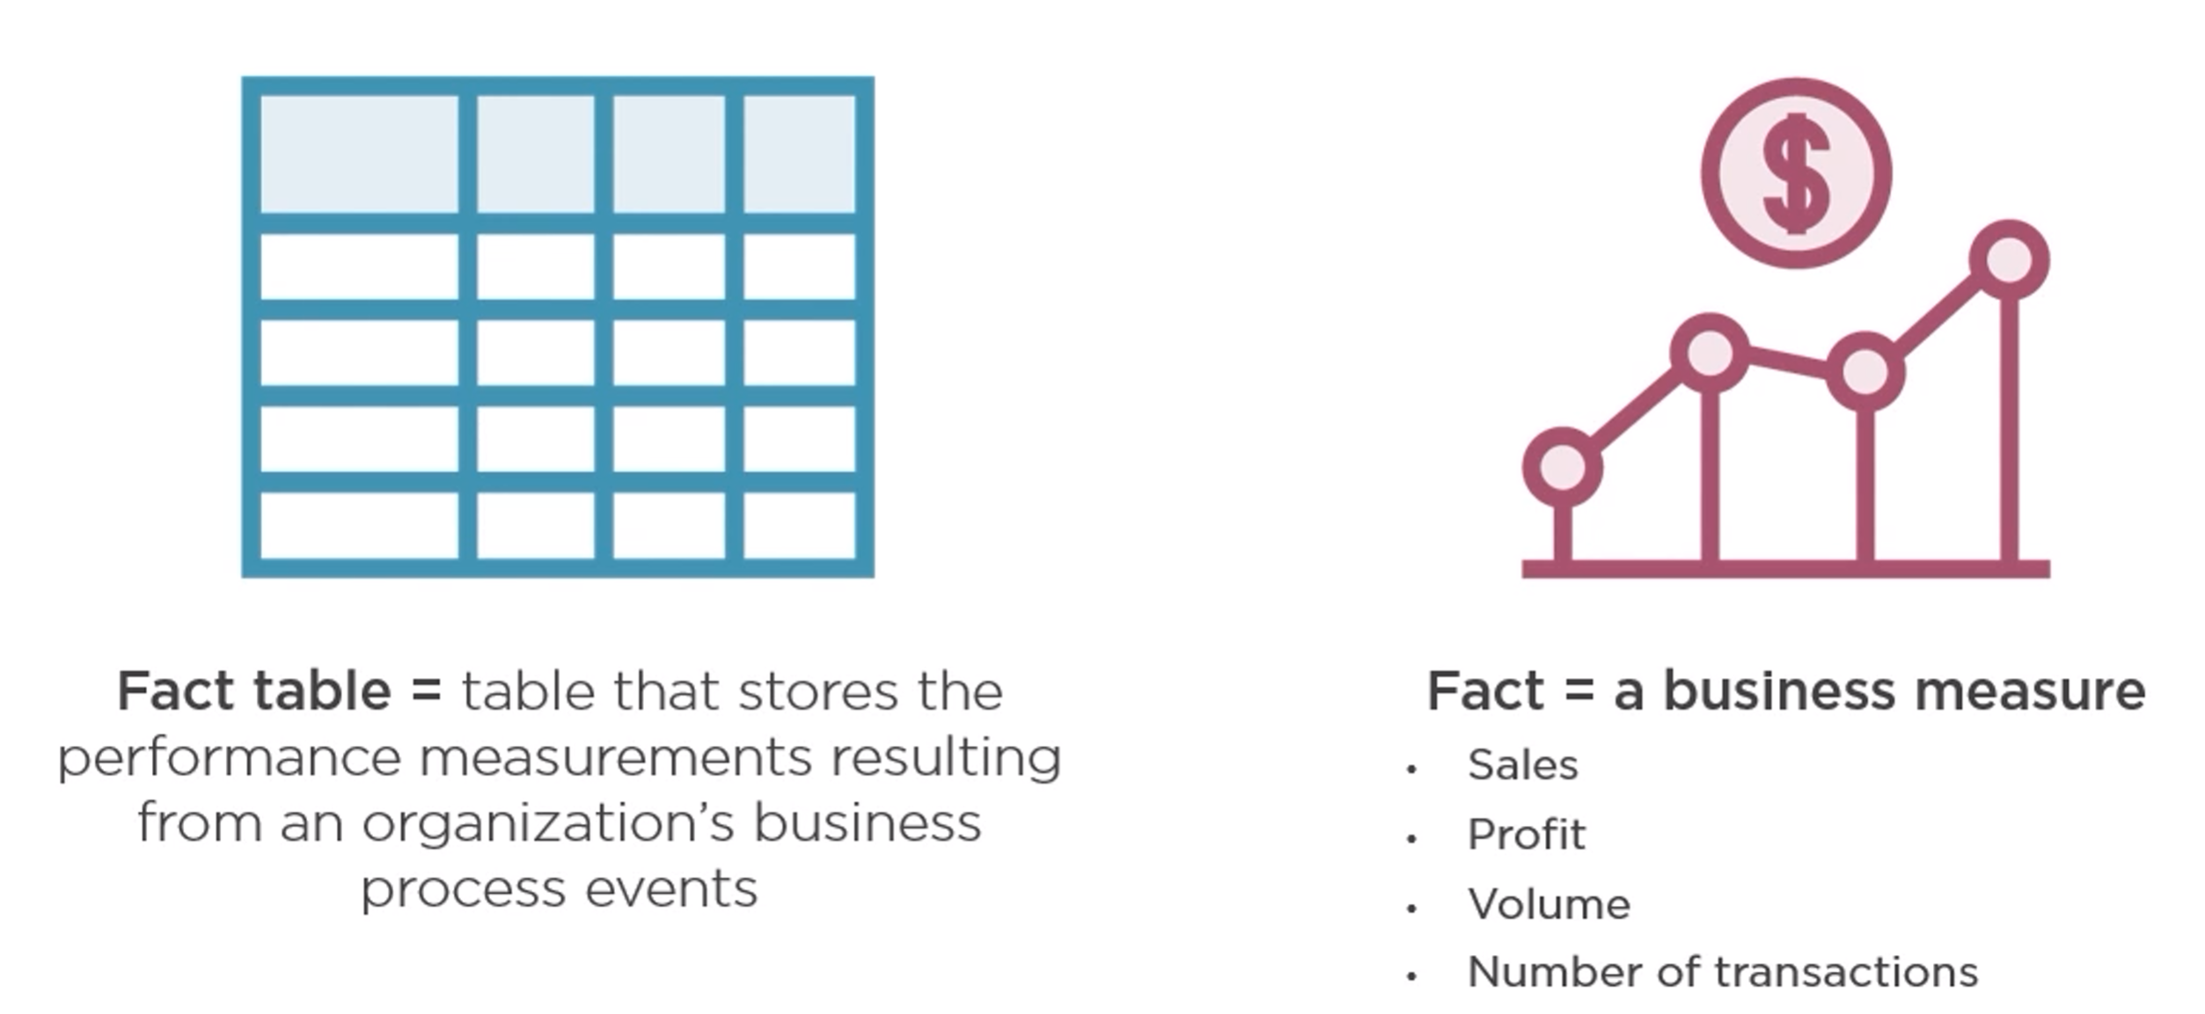
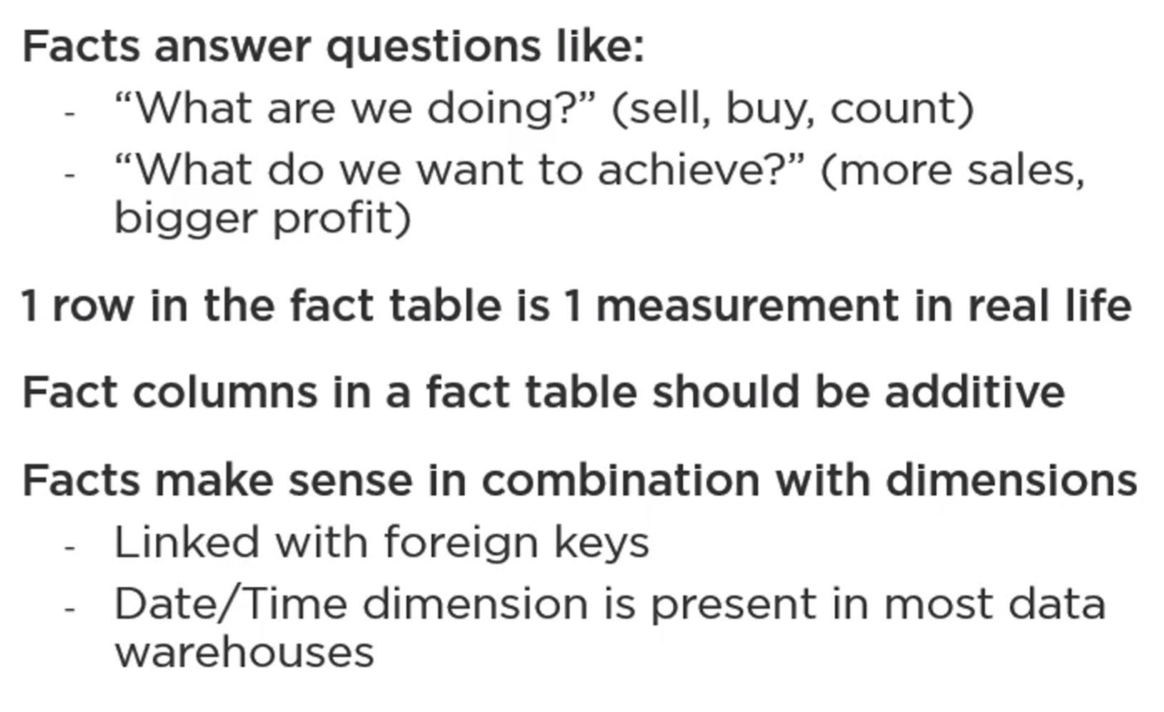
Fact Tables and Facts

Slide 18
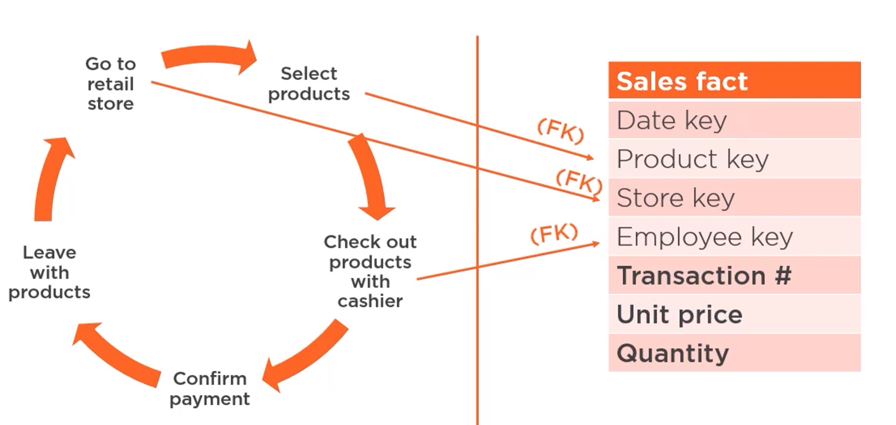

Fact Table Example

Slide 19
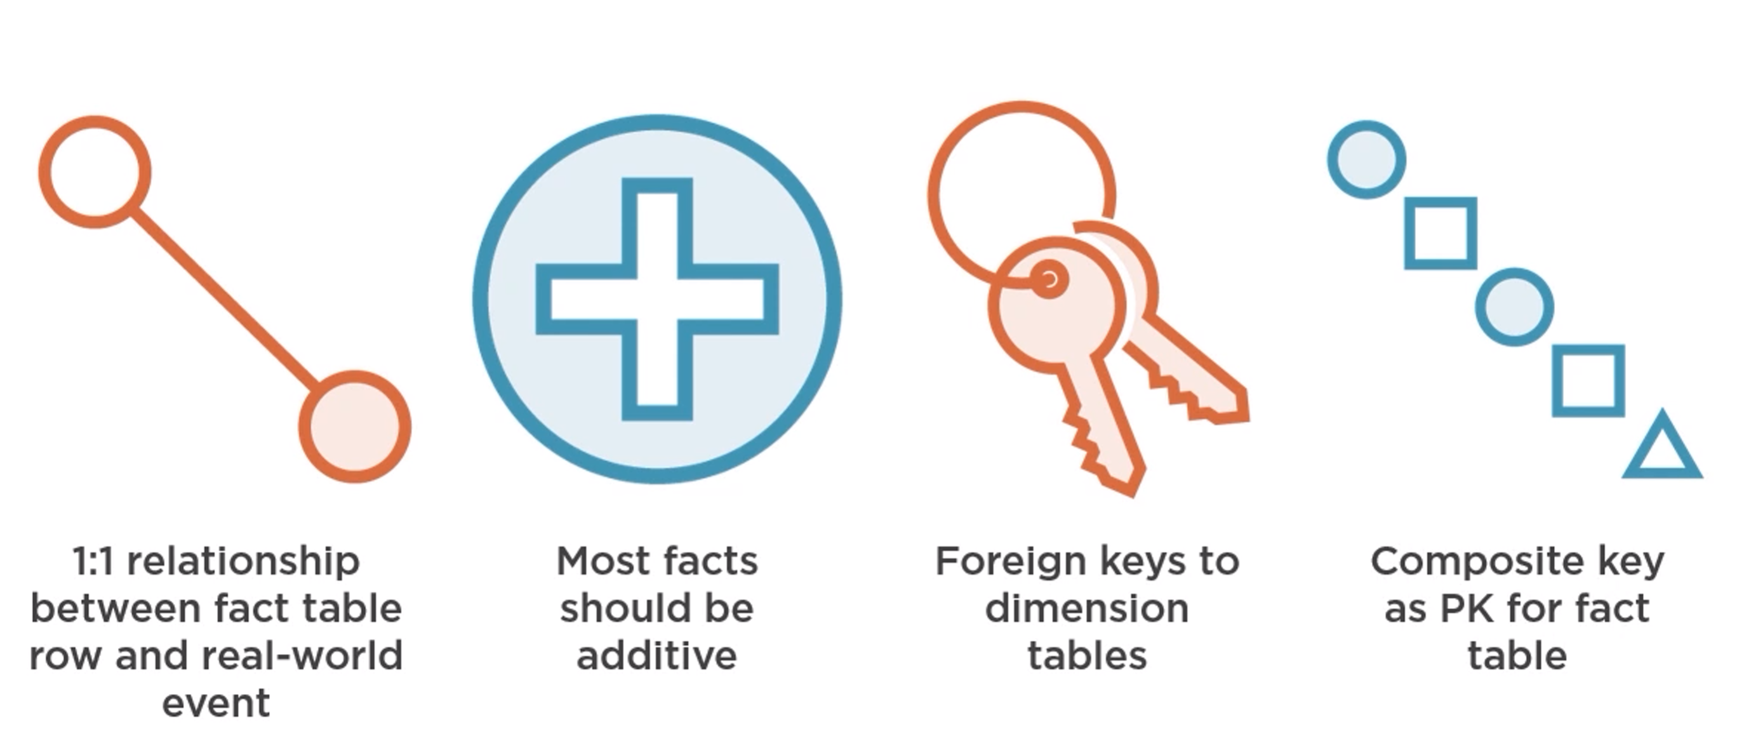
Characteristics of Fact Tables

Slide 20
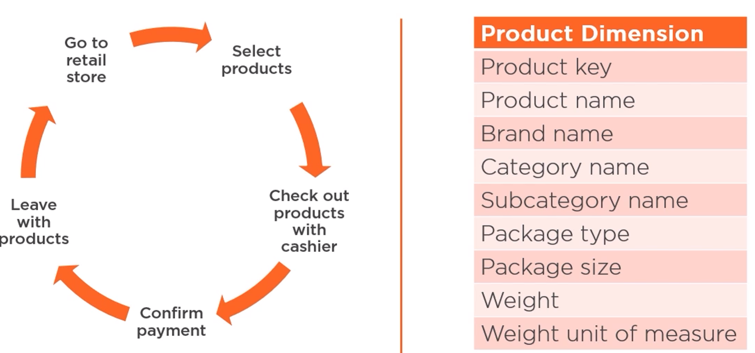
Dimension Table Example

Slide 21
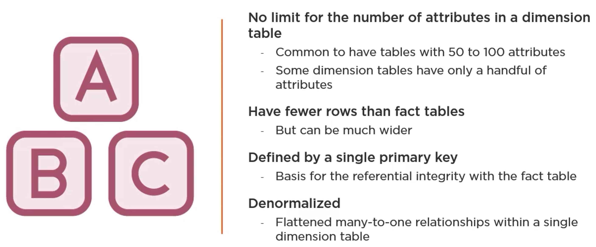
Characteristics of Dimension Tables

Slide 22
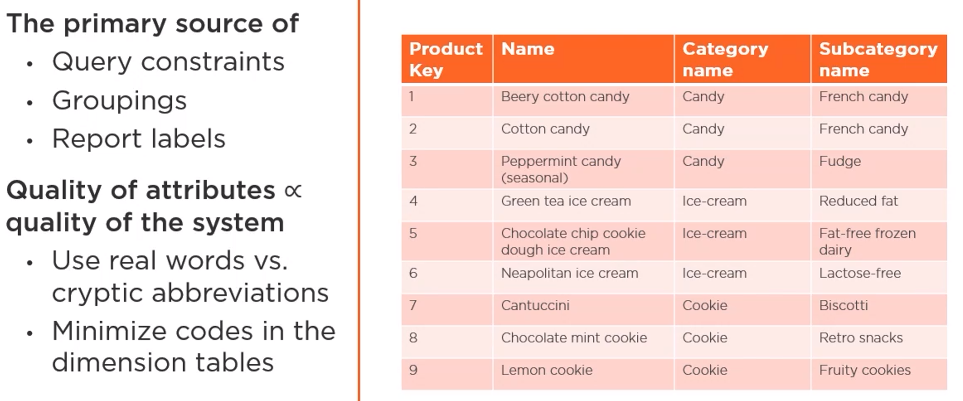
Dimension Attributes

Slide 23
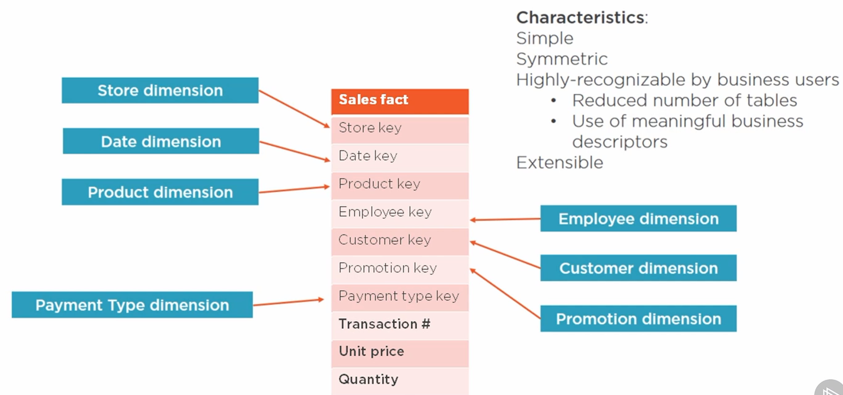
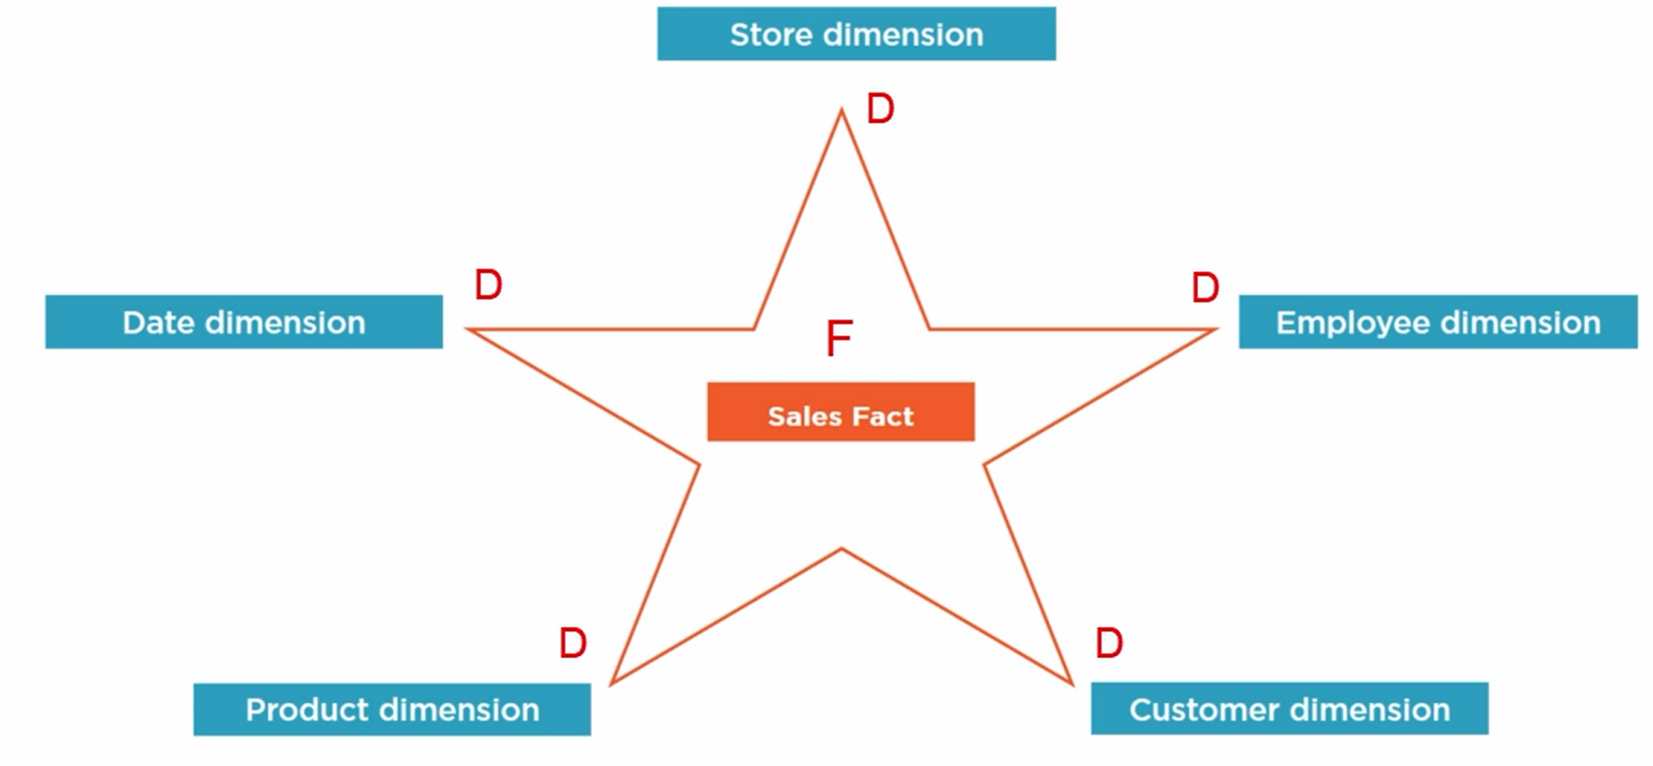
Build a Dimensional Model (Star Schema)

Slide 24
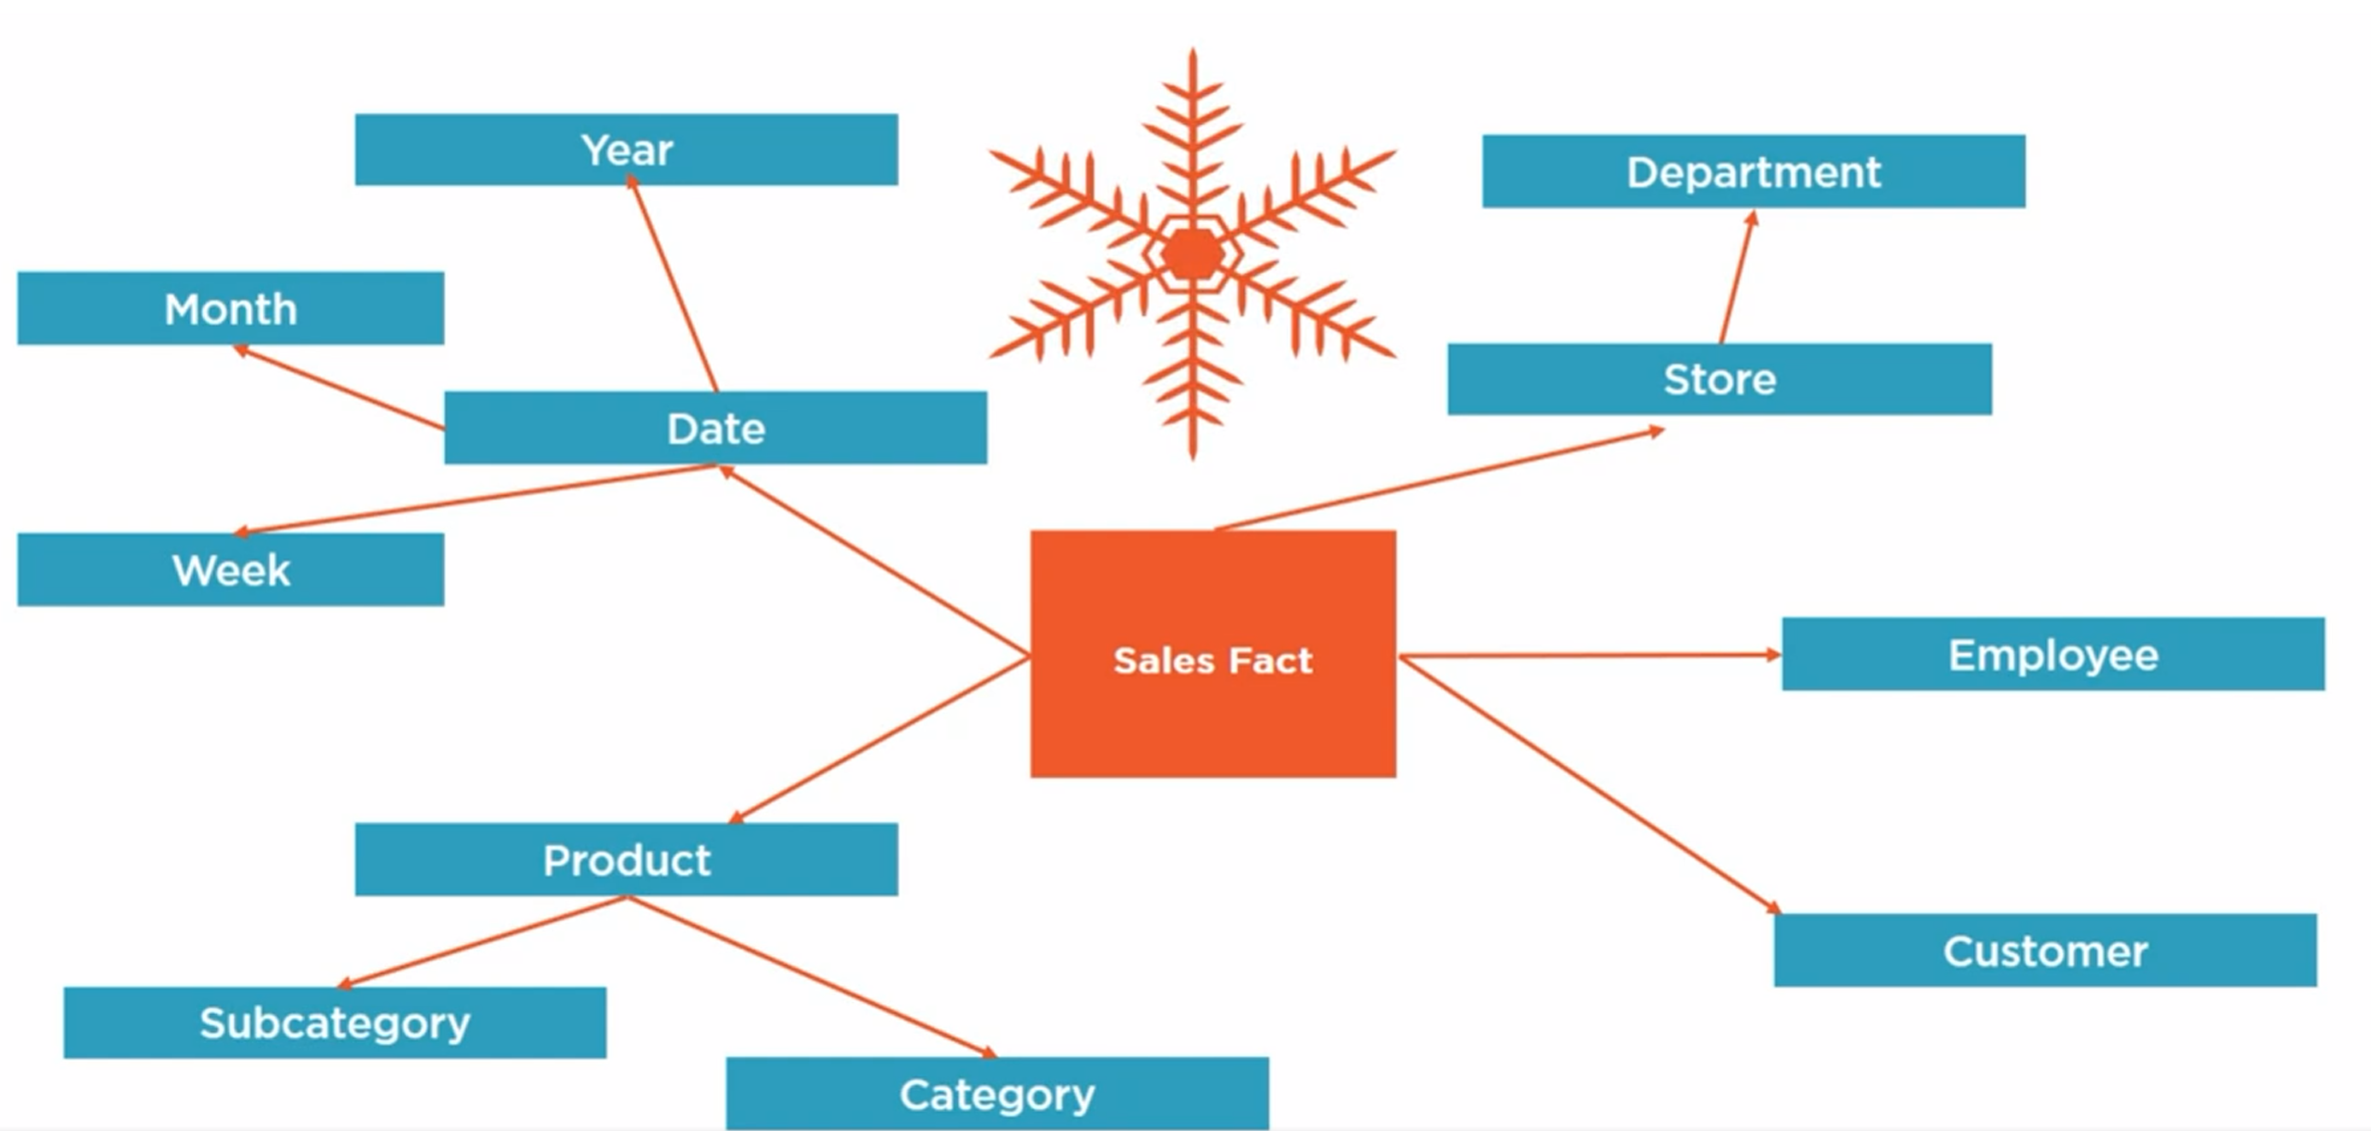
Snowflake Schema

Slide 25
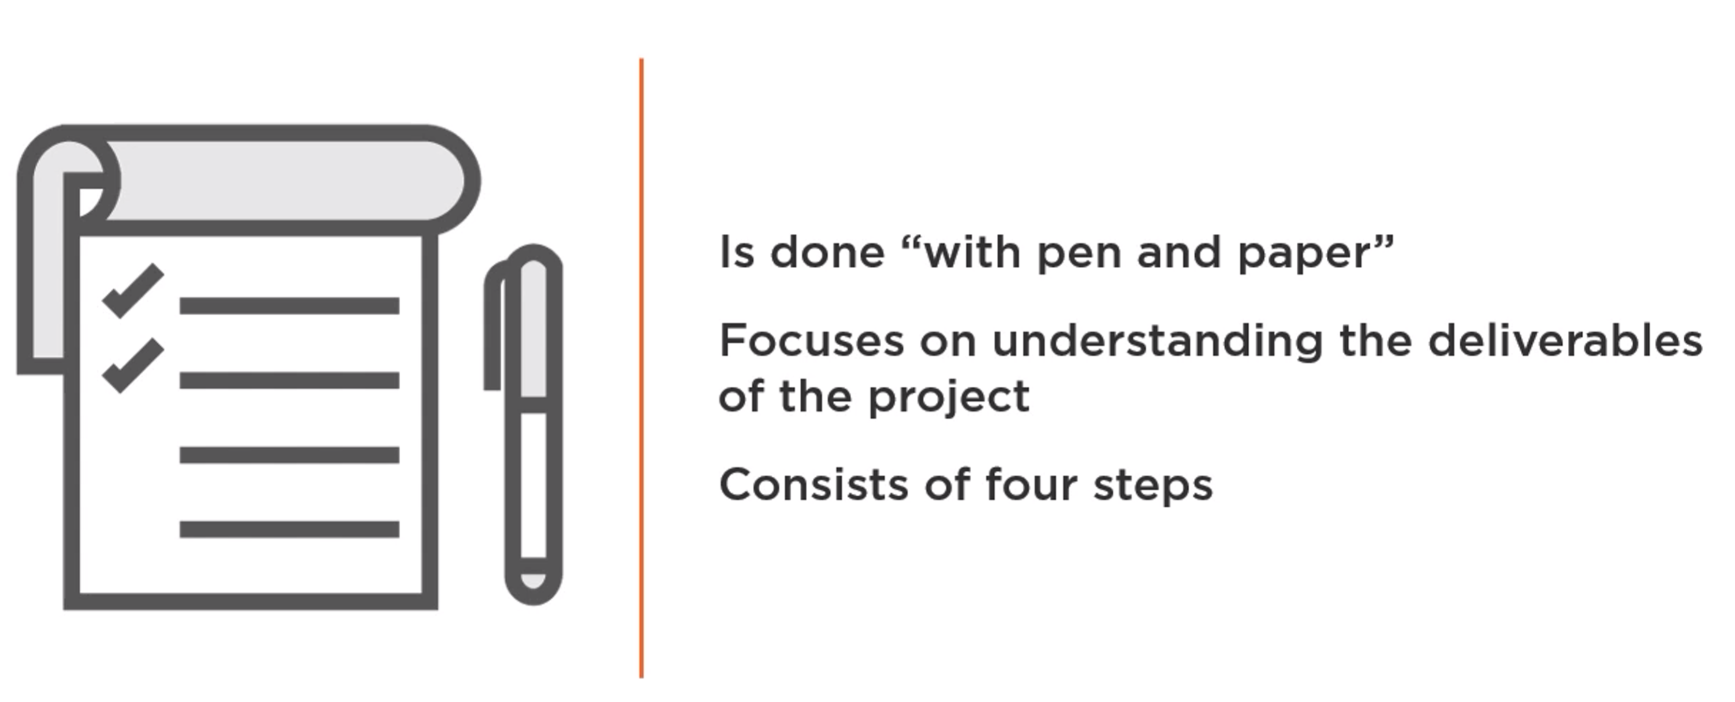
Dimensional Design

Slide 26
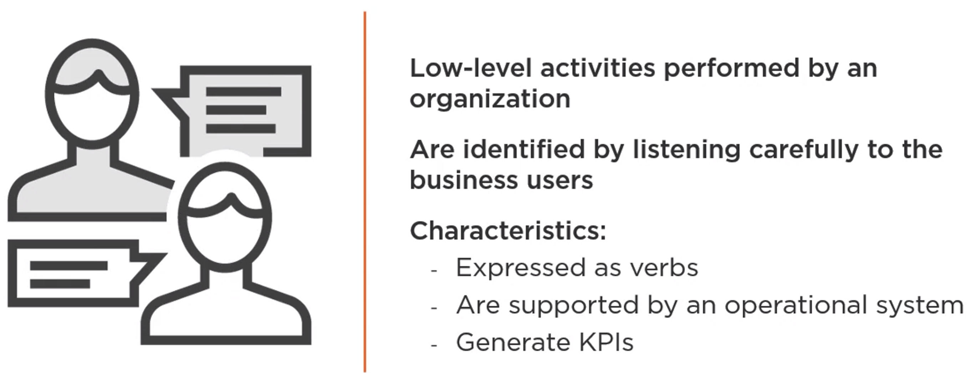
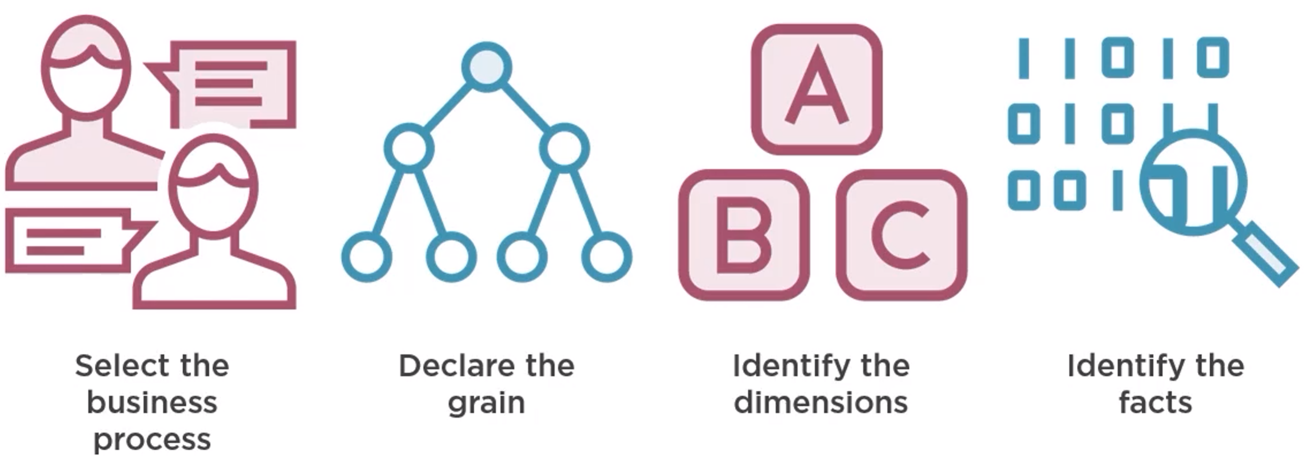
4-Step Design Process

Slide 27
Step 1: Select the Business Process

Slide 28
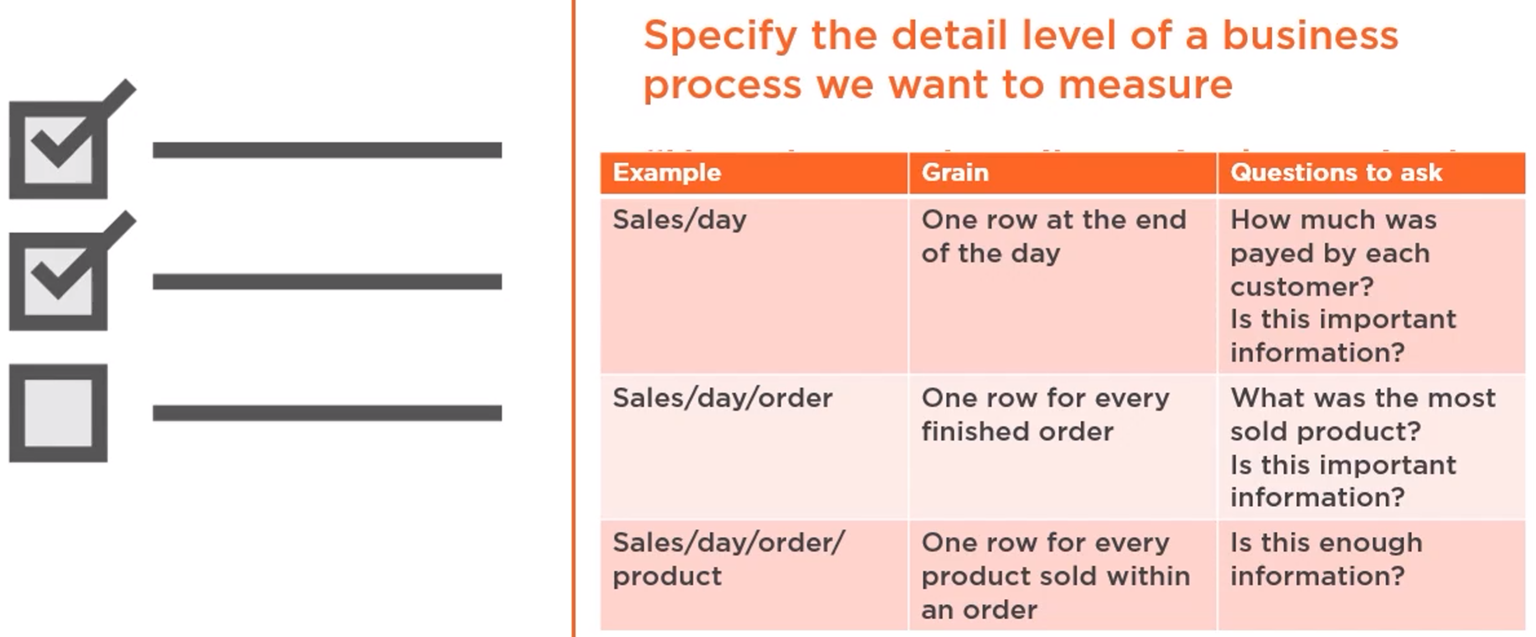
Step 2: Identify the Granularity

Slide 29
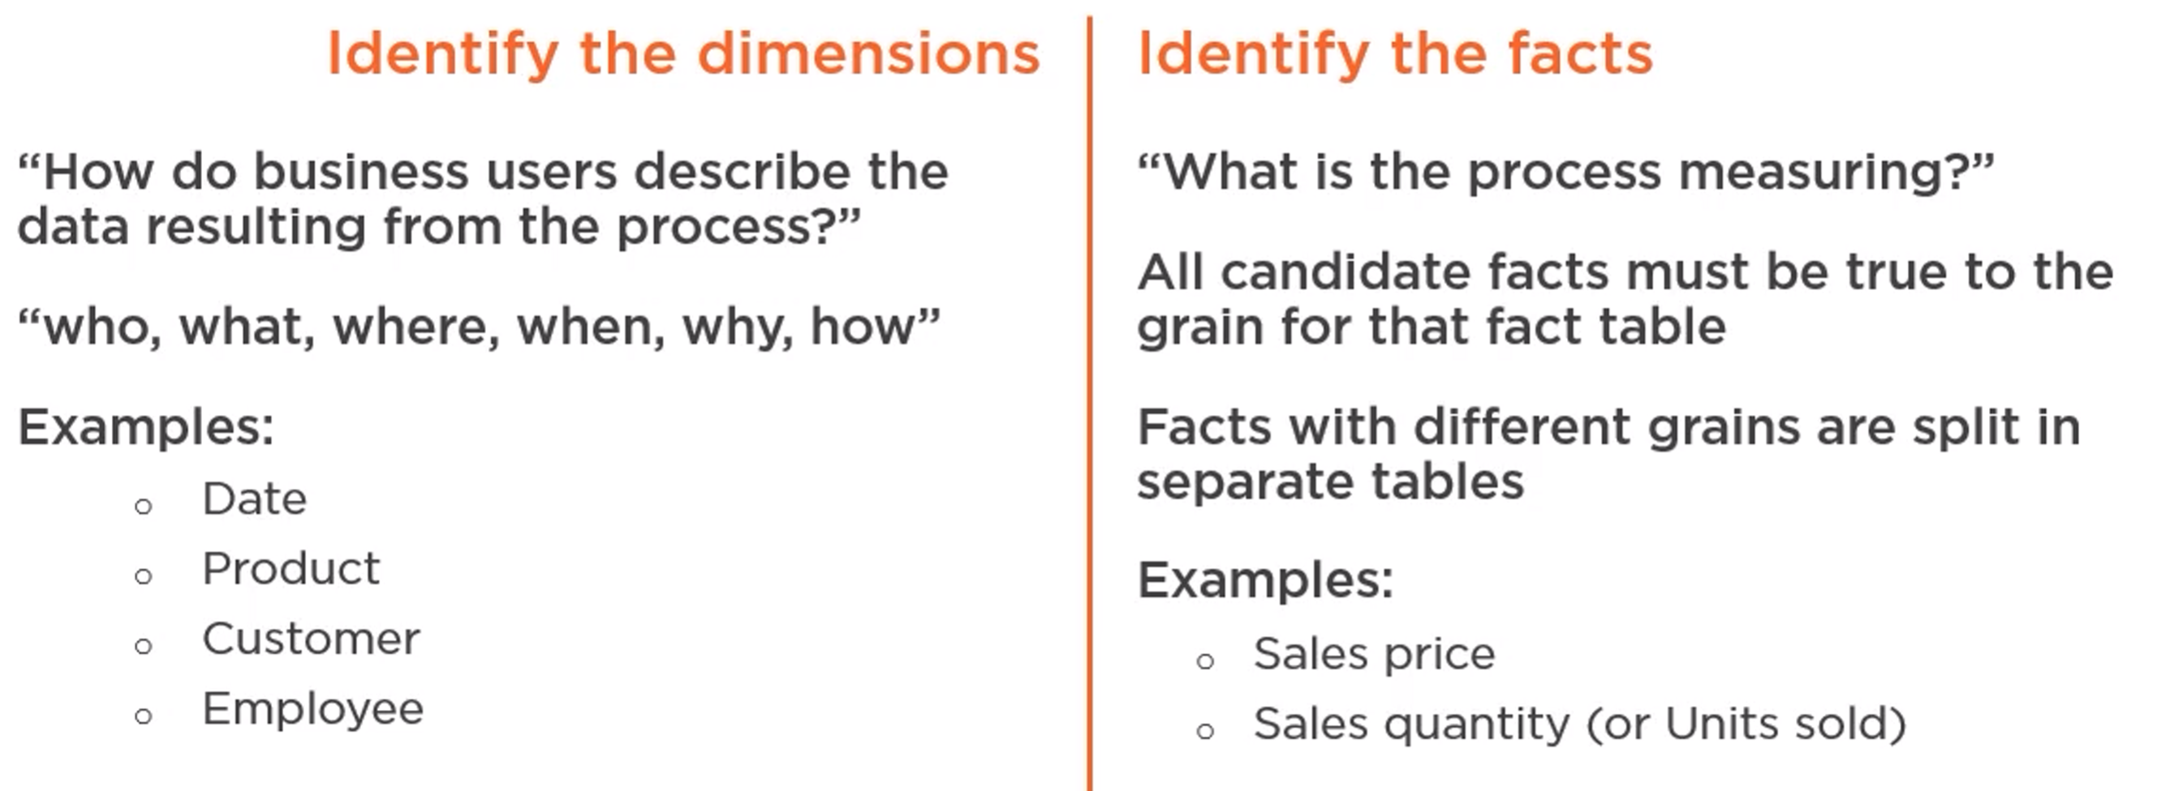
Steps 3-4: Identify Facts, Dimensions

Slide 30

Presentation Layer

Slide 31
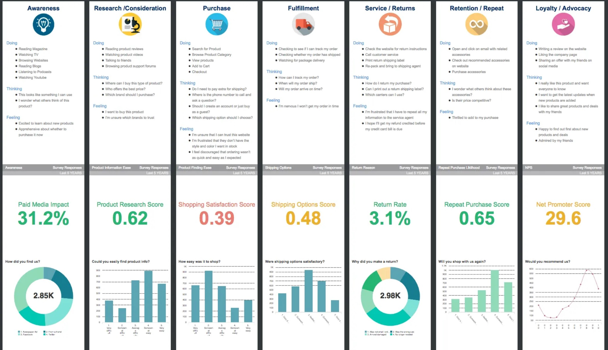

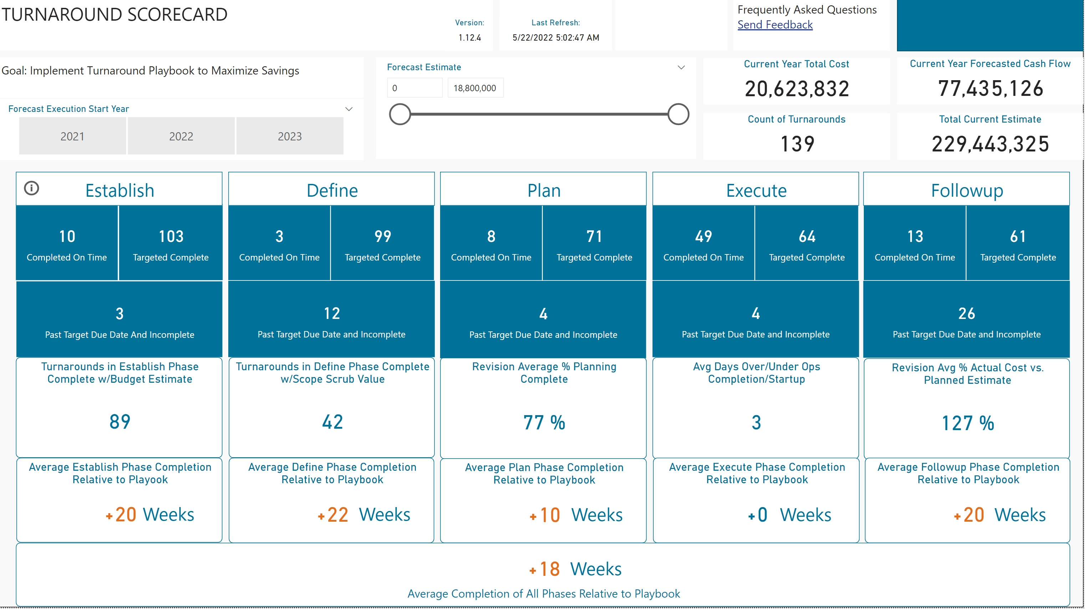

Scorecards

Slide 32
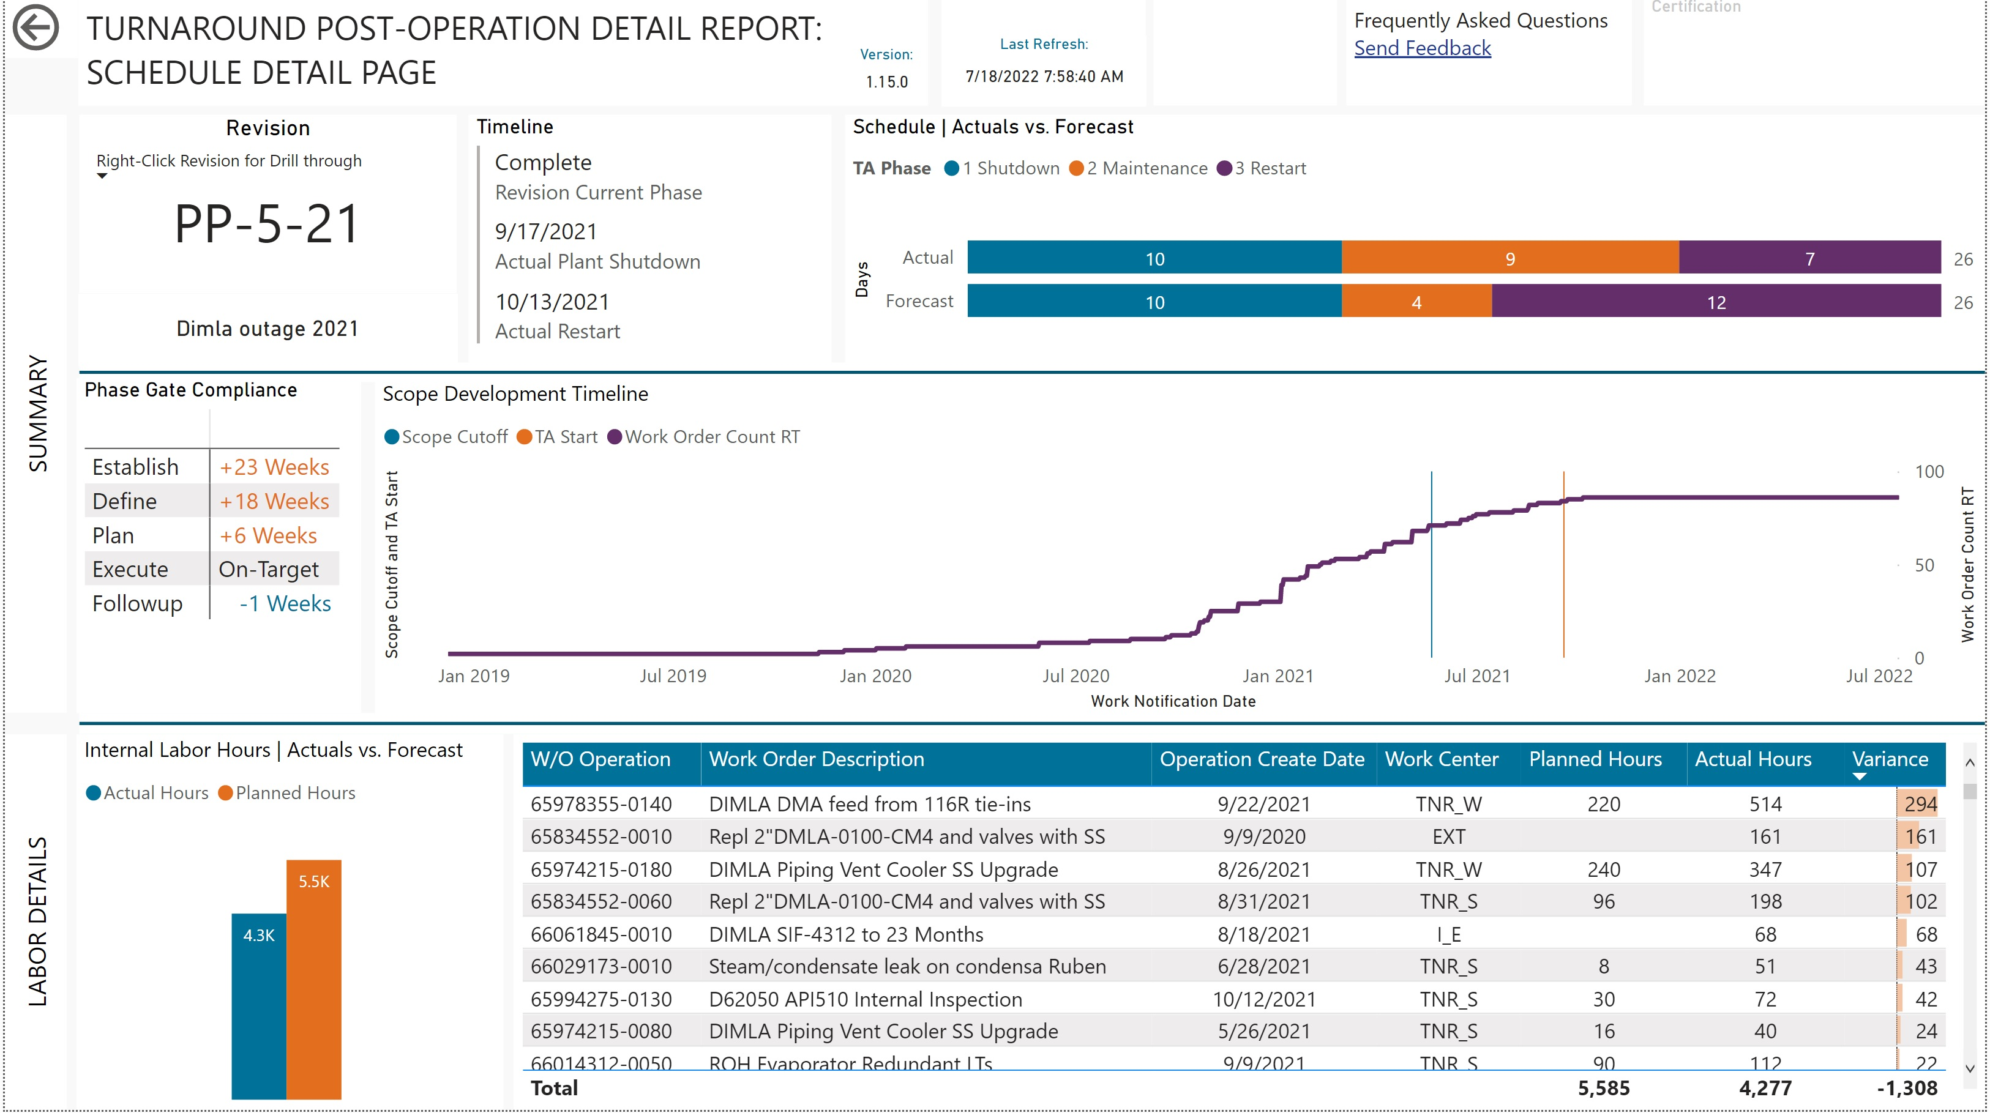
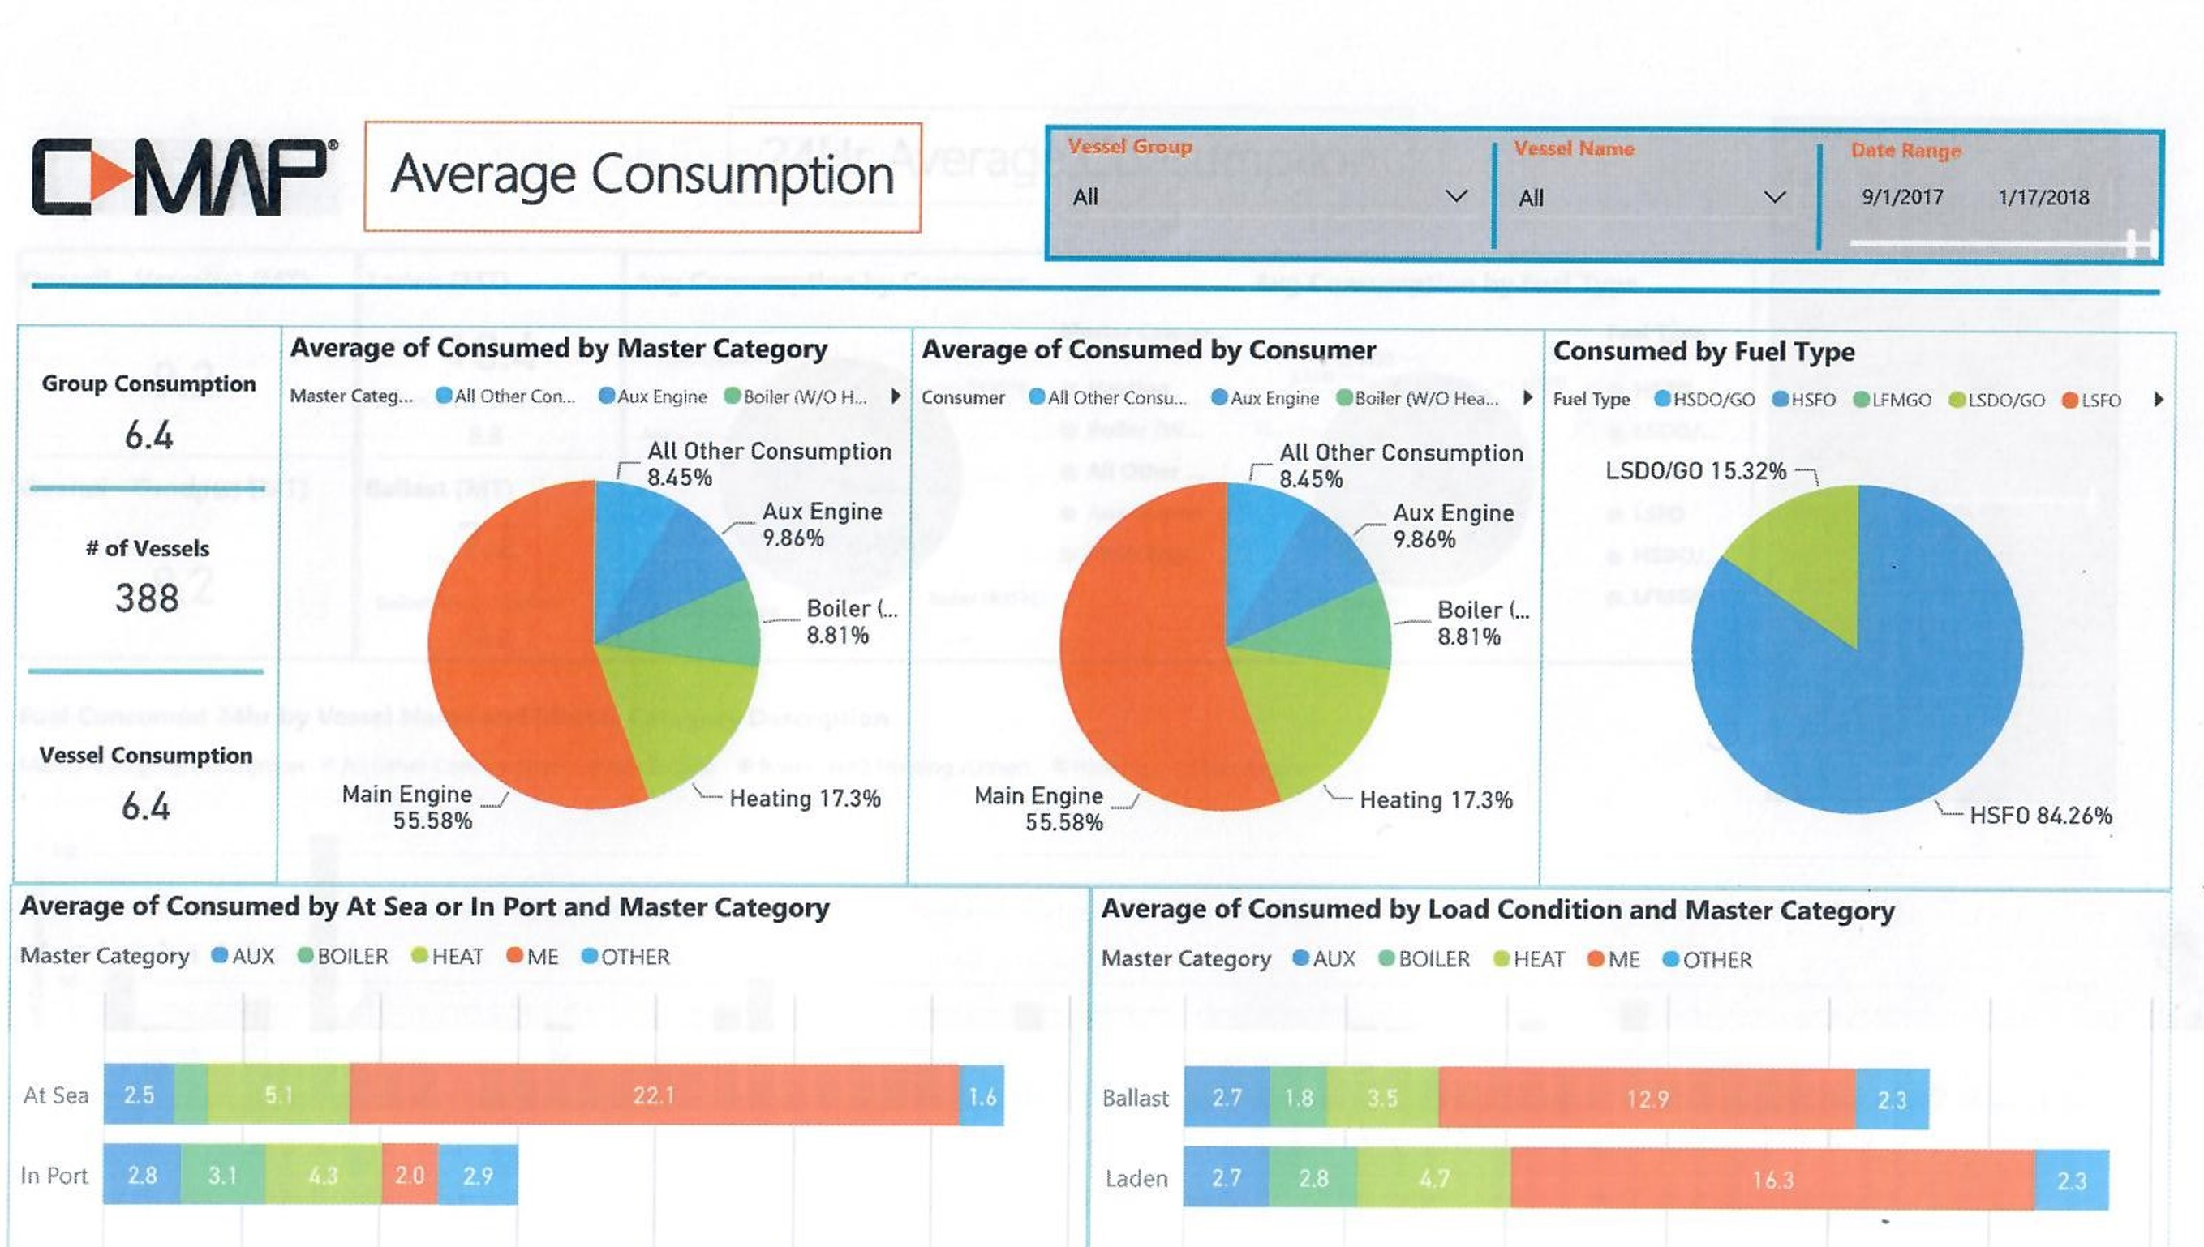

Dashboards

